Slide 1
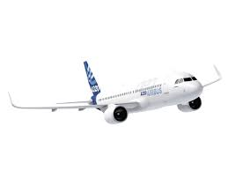
STAPU GmbH & Co KG
GROCHTWEG 32 , D – 59457 WERL
Phone : 0049 02922 – 1320
E – Mail : werl@stapu.de
WebSite : www.stapu.de
G E R M A N Y
ROMANIA - PLOIESTI
STRADA POMPELOR , NR 3 , RO 100411 , PRAHOVA
E – Mail : cradulescu@terqua.com
Phone : 004 0244 521 785
ROMANIA - BRAILA
STRADA OLTENIEI , NR 1 , RO 810082 , BRAILA
E – Mail : cosmin@terqua.com
Cell Phone : 004 0747 136 136
ROMANIA – POIANA MARE
STRADA AGRICULTURII , NR 6 , RO 207470 , DOLJ
E – Mail : terqua.pm@gmail.com
Cell Phone : 004 0755 061 126
R O M A N I A
L U P R O M
REPUBLICA MOLDOVA - STRASENI
STRADA VICTOR CRASESCU , NR 1 , ZEL BALTI
SUBZONA NR 4 , STRASENI
IDNO : 1017600038668
E – Mail : eu.marketing30@gmail.com
Phone : 00373 680 95 012
M O L D O V A

Slide 2
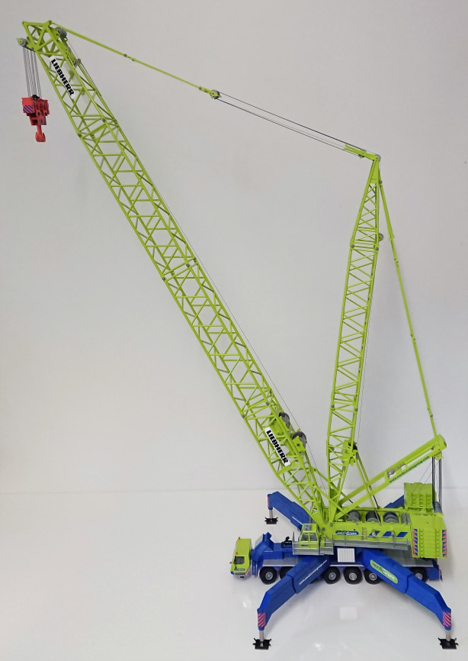
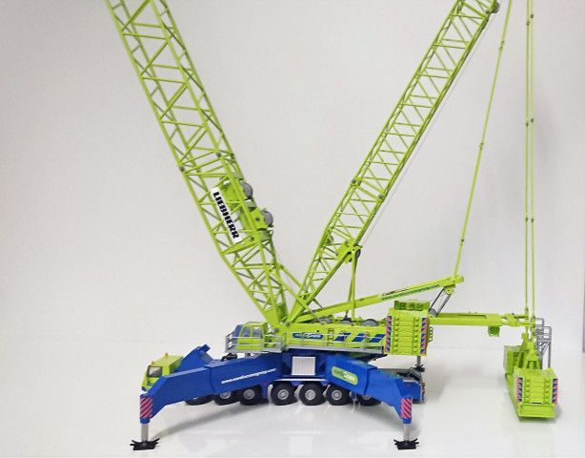
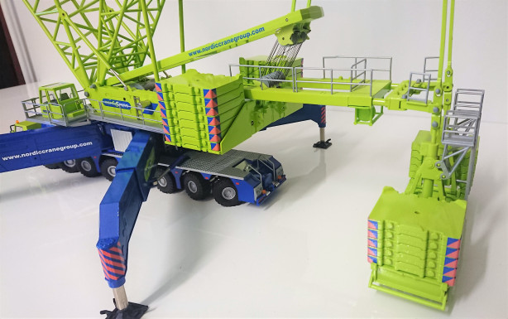
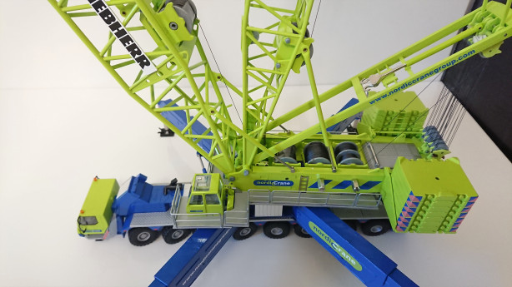
CUSTOMERS
L U P R O M
L I E B H E R R
C O U N T E R W E I G H T

Slide 3
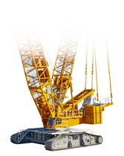
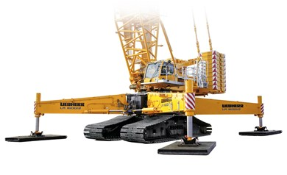
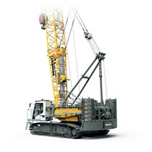
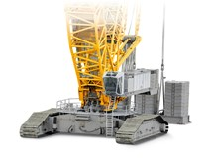
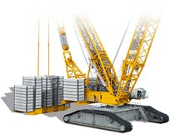
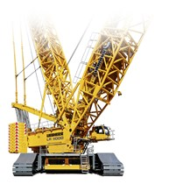
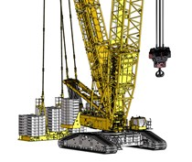
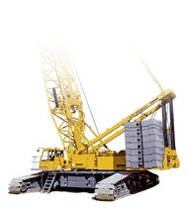
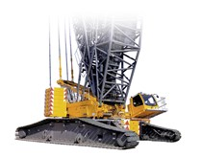
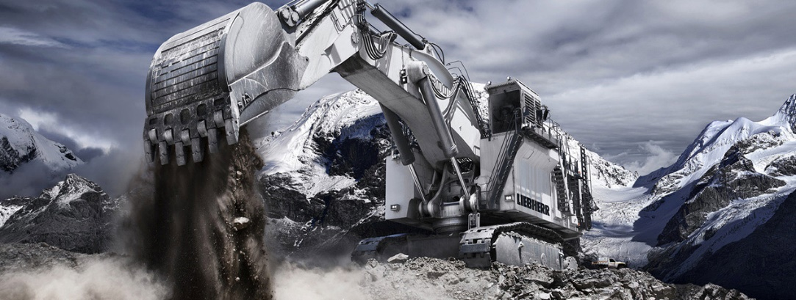
L I E B H E R R
CUSTOMERS
C O U N T E R W E I G H T
L U P R O M

Slide 4
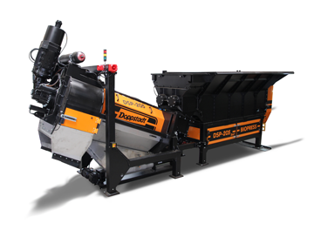
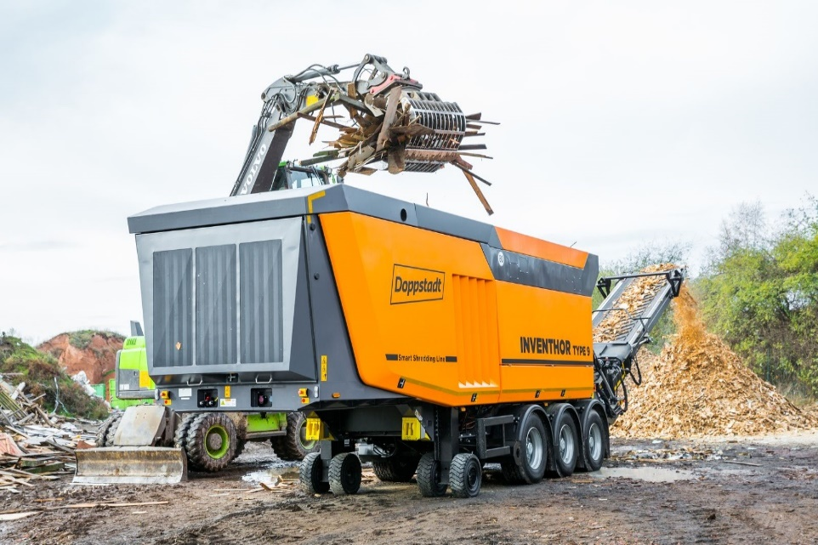
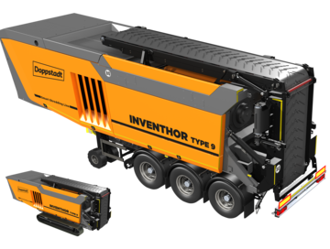
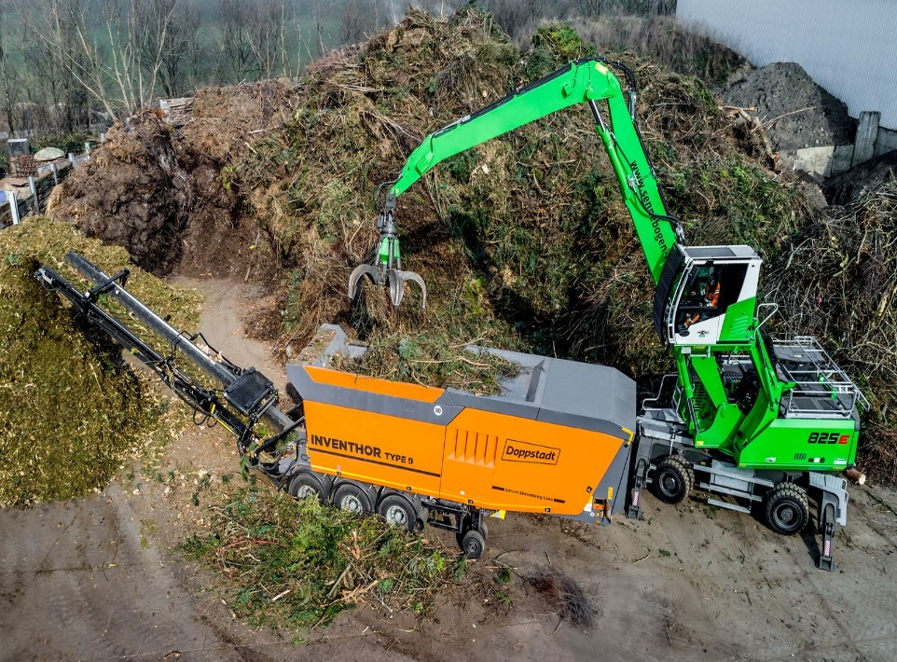
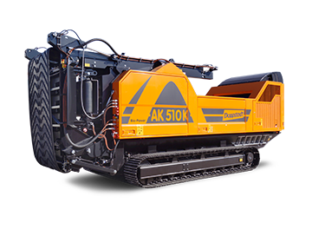
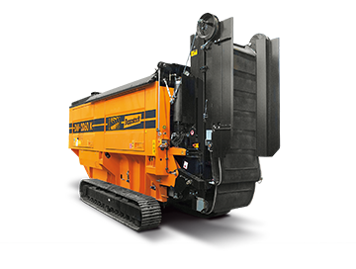
D O P P S T A D T
CUSTOMERS
C H A S S I S
Doppstadt is a modern enterprise with tradition. In 1965 Werner Doppstadt founded an agricultural company at Velbert, which today is a worldwide leading partner in the field of environmental technology.
Competent, highly motivated employees plan, realize and produce recycling machines and plants – mobile and stationary – for processing various materials such as waste wood, garbage, industrial waste, biowaste, excavated earth and green waste.
For our customers in more than 40 countries we make an important contribution to the protection of the environment and to the preservation of ressources.
L U P R O M

Slide 5
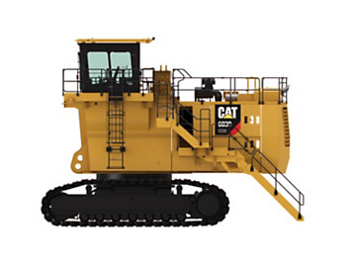
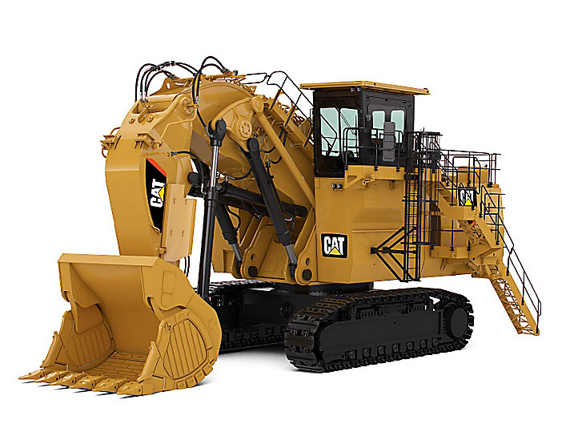
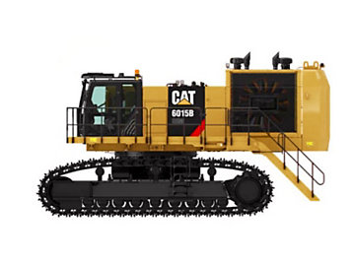
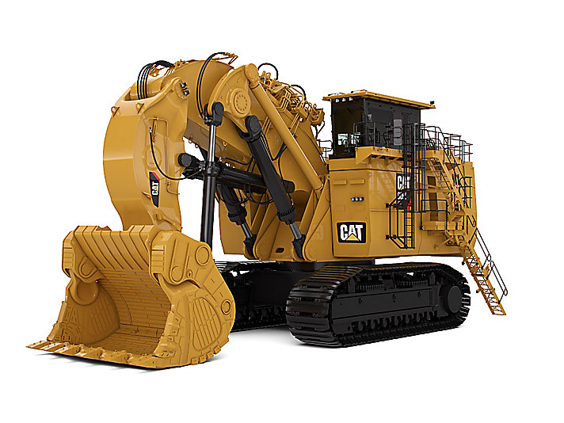
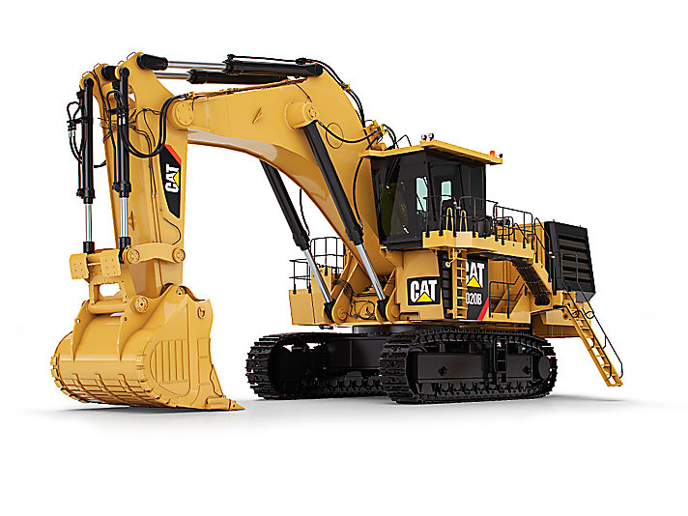
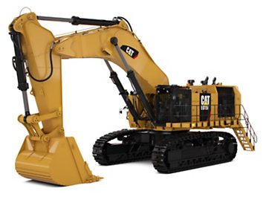
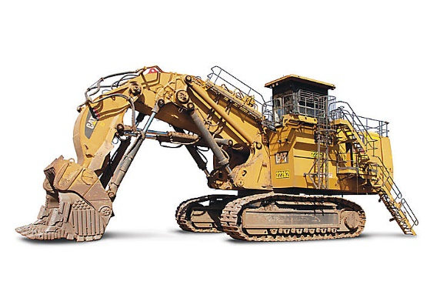
C A T E R P I L L A R
CUSTOMERS
INDUSTRY SOLUTIONS : MINING THE BROADEST PRODUCT LINE IN THE INDUSTRY.
Today, the demand for mined materials is greater than at any other time in history. World development and increased urbanization are driving sustained dependence on minerals, metals and coal. Energy usage is expected to increase sigfificantly in the coming decades - placing even more emphasis on supply, security, cost and environmental impact issues.
As the demand for commodoties grows, mining companies need a partner to support them in their efforts. A partner who understands the issues important to the mining industry - like safety, sustainability and productivity. And a partner with the equipment, solutions and technologies to support their operations.
Caterpillar is committed to being that partner. We provide the broadest line of surface and underground equipment in the industry - backed by the people and the infrastructure to serve every mining region in the world.
T E R Q U A
HYDRAULIC OIL AND WATER TANKS

Slide 6
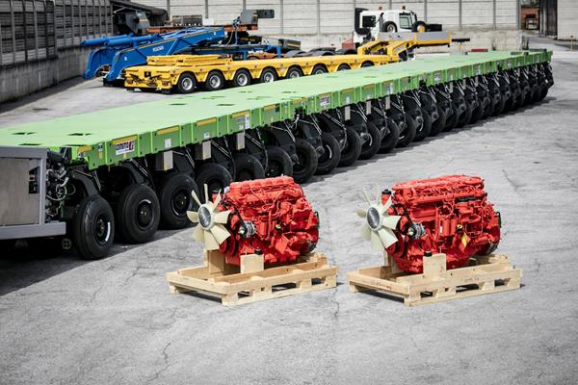
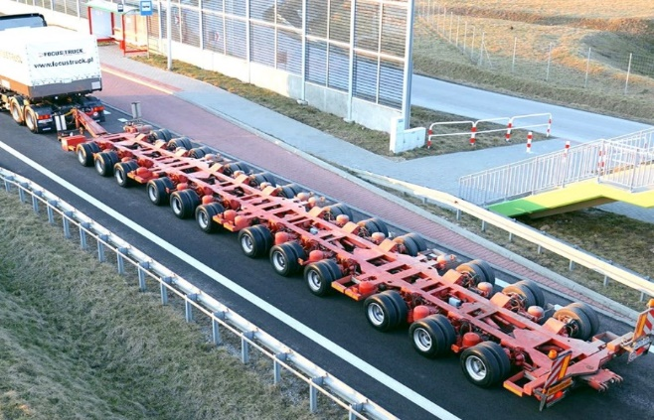
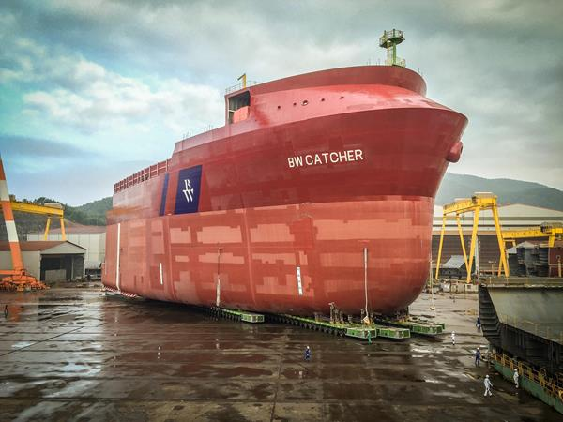
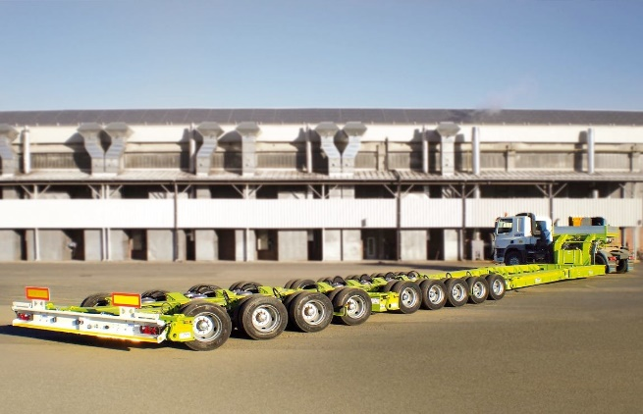
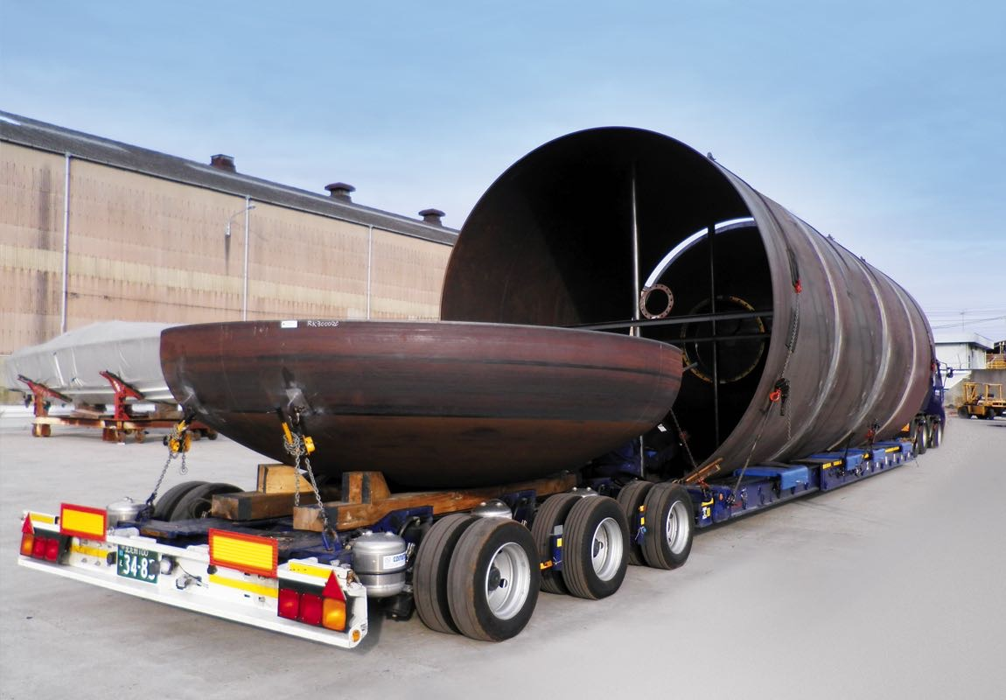
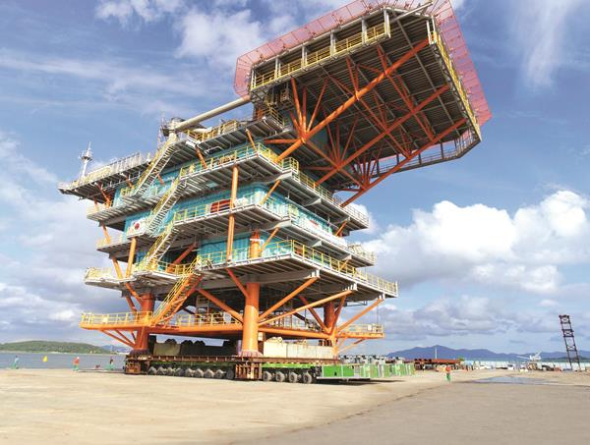
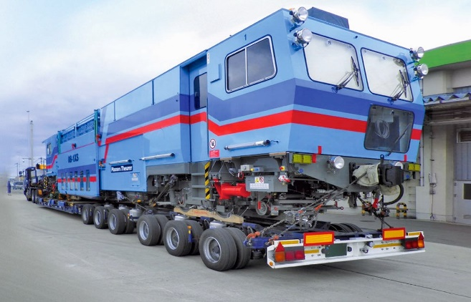
C O M E T T O
CUSTOMERS
CHASSIS – MODULAR SYSTEMS
The Faymonville Group is one of the leading full-range manufacturers of special vehicles for heavy load transport and special transport.
The semi-trailers, low-loaders, modular vehicles and self-propelled vehicles that we produce can be used to transport anything exceptionally heavy, long, wide or tall!
T E R Q U A

Slide 7
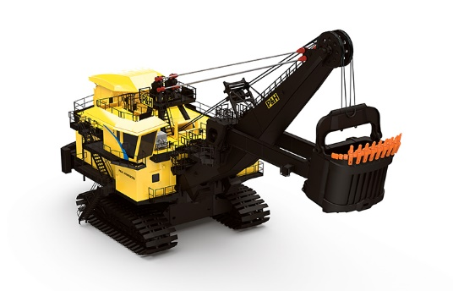
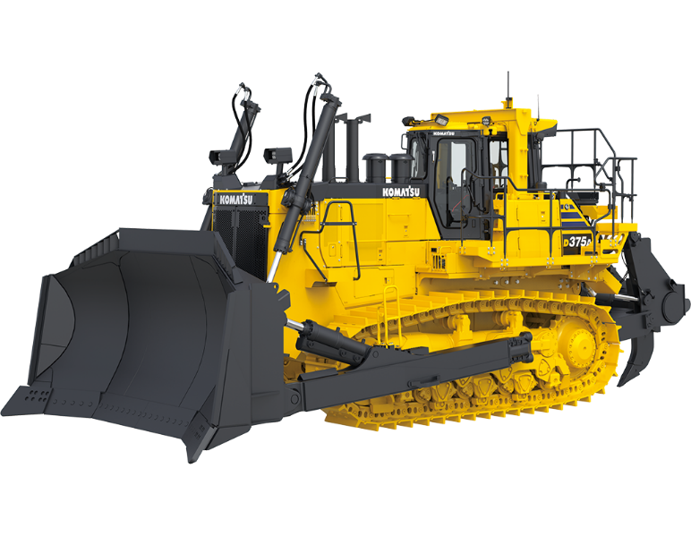
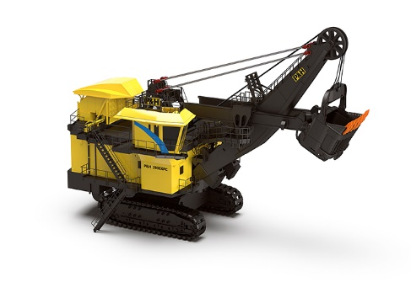
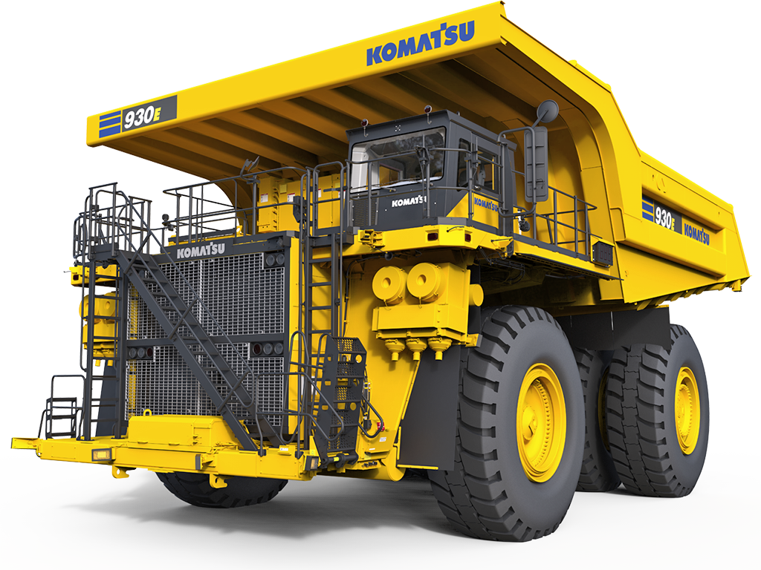
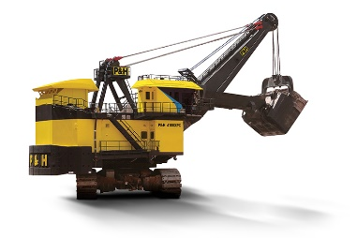
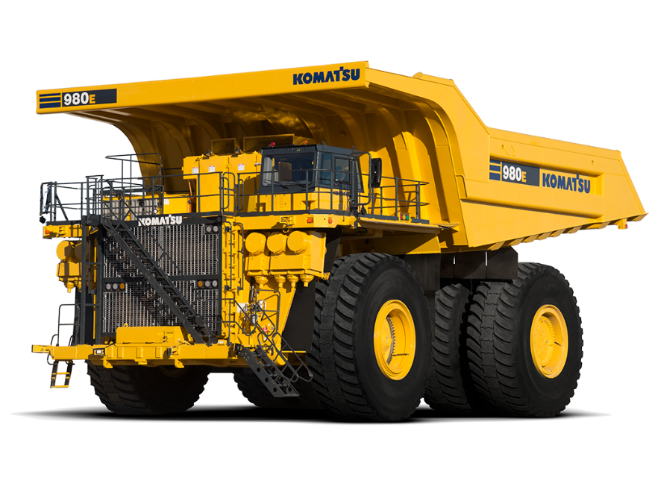
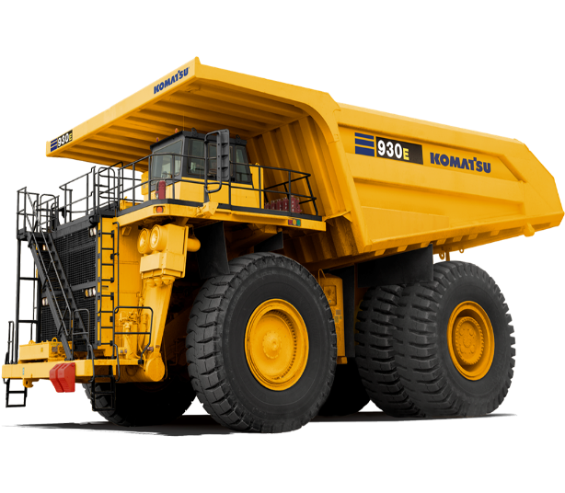
K O M A T S U
CUSTOMERS
C O U N T E R W E I G H T
Manufacture and sale of construction and mining equipment, utilities, forest machines and industrial machinery.
HYDRAULIC OIL AND WATER TANKS
T E R Q U A

Slide 8
PRESENTATION
Founding Year : 2017
Capital : 100% German
Activity : Production of counterweights for heavy cranes and excavators
Production of tanks for hydraulic oil, fuel and water - excavators and cranes
LUPROM is part of the STAPU GmbH Holding, the largest European manufacturer in the field.
THE STRATEGY OF THE LUPROM COMPANY FOR THE PERFECTION OF FUTURE EMPLOYEES:
He has a partnership agreement with the Engineering College of the Free Economic Zone. The Engineering College is the first institution
of Moldovan education that fully implements the dual German training system and aims to prepare the force
of qualified work both for Moldovan companies, but especially for foreign investors. It's important that the system
dual is characterized by an effective partnership between the educational institution and the partner enterprises.
For personnel recruitment or following institutions:
NATIONAL EMPLOYMENT AGENCY PROFESSIONAL SCALE PROFILE.
Within LUPROM training courses are also being offered for unskilled workers in the field of welding or assembling - locks.
VACANCIES :
Welders ( MIG – MAG ) ( welding with CORGON 18 ) , vacancies : 60
Montatus - Lacatus (subassemblies and polishing of finished parts ) , vacancies : 30
Sablori ( saves the pieces with alice metal and prepares them for priming ) , vacancies : 4
Dyers ( receive sandblasted products , manual painting ) , vacancies : 4
Secretary ( to work on the computer – office , word , x-cell , communications ) , vacancies : 1
Assistant Manager ( keep daily agenda , computer notions , marketing experience ) , vacancies : 2
Students ( for Straseni College , ages 18-35 ) , vacancies : 10
Woman of Service , vacancies : 4
Roller operator , vacancies : 4
Supply ( supplier identification , price negotiation ) , vacancies : 1

Slide 9
PRESENTATION
IMPROVEMENT COURSES :
The best workers will be selected and will undergo training courses in Germany and Romania or internally .
The motto of the company is : The best investment is in your people , they create plus the value of the company , so they have priority .
SALARIZATION :
1. For students ( professional schools ) , the salary starts from the amount of 3,500 lei ( net ) up to 6,500 lei ( net ) .
2. For people coming from unemployment or other areas and wanting to qualify in the field of welding or fitter , the salary is 6,500 lei ( net ) .
3. For students who are over 18 years of age and are selected for Straseni College and for Luprom , the salary starts from the amount of 2,950 lei ( net ) up to 6,500 lei ( net ) + Accommodation in the hostel and the school is paid by the Employer .
4. For the persons who are qualified , the salary starts from the amount of 6,500 lei ( net ) + ( the first agreement + the mass vouchers ) and can reach up to 16,000 lei ( net ) .
IMPORTANT:
For people who are from other localities and want to work in our company, we can offer them accommodation for a fee .
S T A P U

